Slide 1
Data Analysis
Presented By
Dipali Ziman
Vikas Bhagure

Slide 2
Index
Introduction To Data Analysis
How To Explore Data
From Data Analysis to Inference
Conclusion

Slide 3


Data Analysis
  It is the process of organizing, displaying, summarizing, and asking questions about data.
Data Analysis
Definitions:
Individuals – objects (people, animals, things) described by a set of data
Variable - any characteristic of an individual
Categorical Variable
– places an individual into one of several groups or categories.
Quantitative Variable
– takes numerical values for which it makes sense to find an average.

Slide 4
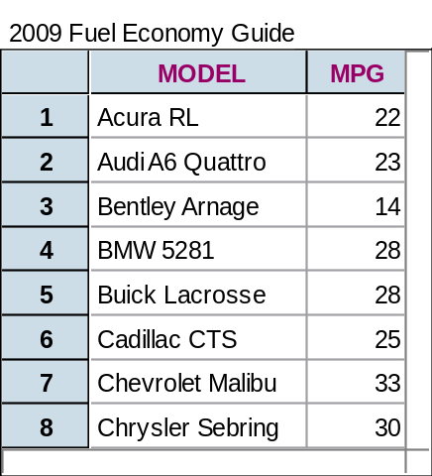
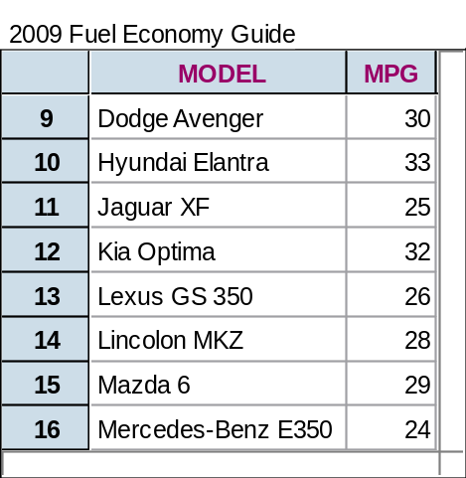
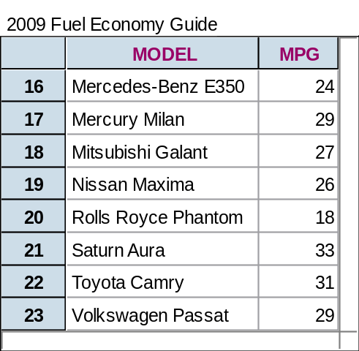


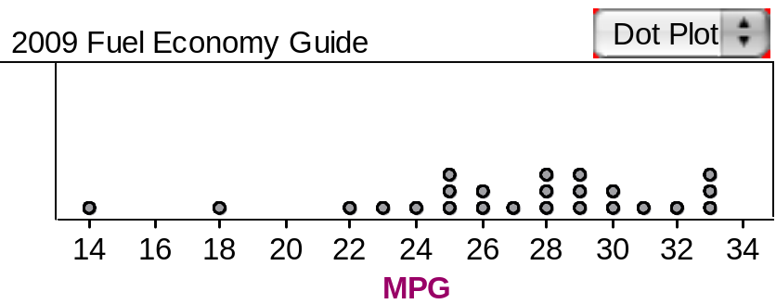
Data Analysis
A variable generally takes on many different values. In data analysis, we are interested in how often a variable takes on each value.
Definition:
Distribution – tells us what values a variable takes and how often it takes those values
Example
Dotplot of MPG Distribution
Variable of Interest:
MPG

Slide 5


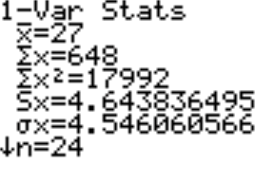
Data Analysis
How to Explore Data
Examine each variable by itself.
Then study relationships among the variables.
Start with a graph or graphs
Add numerical summaries

Slide 6



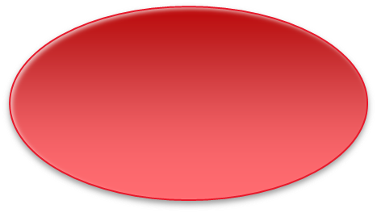


Data Analysis
From Data Analysis to Inference
Population
Sample
Collect data from a representative Sample...
Make an Inference about the Population.
Perform Data Analysis, keeping probability in mind…

Slide 7
Conclusion
  A dataset contains information on individuals.
  For each individual, data give values for one or more variables.
  Variables can be categorical or quantitative.
  The distribution of a variable describes what values it takes and how often it takes them.
  Inference is the process of making a conclusion about a population based on a sample set of data.

